Slide 1

Project Title -Seasonal Agriculture Performance Analysis
Student Name - Smruti Saurav Nayak
College Name- Synergy Institute of Engineering & Technology,Dhenkanal
AICTE STU ID :STU680b54c2a73b81745573058

Slide 2

PROBLEM STATEMENT
Agricultural activities are influenced by seasonal variations in environmental conditions, farming practices, resource availability and market conditions. As a result, agricultural performance may differ from one season to another. However, raw agricultural data does not clearly explain how agricultural performance changes across seasons or what patterns can be observed in different seasonal conditions. The problem is to analyze the given agricultural dataset and investigate seasonal differences in agricultural performance by identifying meaningful patterns, trends, relationships and variations within the available data.

Slide 3
Project Description
The "Seasonal Agriculture Performance Analysis" project investigates how agricultural performance fluctuates due to seasonal variations in environmental conditions and resource availability. Because raw data alone does not explain these changes, the objective is to clean the dataset and analyze how resource usage, crop yields, and economic outcomes vary across different farming seasons. By discovering relationships within the data—such as the impact of rainfall or irrigation methods on profitability—and applying statistical and visual analytics, the analysis culminates in a fully documented Jupyter Notebook containing evidence-based recommendations to support improved seasonal agricultural planning.

Slide 4

WHO ARE THE END USERS?
Agricultural Planners: Rely on the insights to support evidence-based seasonal agricultural planning and policy-making.
Farmers and Producers: Use the performance data to understand changing environmental conditions, adjust resource usage, and improve overall crop yields across different seasons.
Agronomists and Researchers: Analyze the identified patterns and relationships between environmental conditions and agricultural outcomes to guide further scientific investigation.
Agribusinesses and Market Analysts: Track seasonal economic variations and performance trends to optimize supply chain logistics, investments, and financial planning.

Slide 5

Technology Used
Python: Core programming language for data manipulation and analysis logic.
Jupyter Notebook: Environment used to document the complete analysis, code, and final findings.
Pandas, Matplotlib & Seaborn: Python libraries for data cleaning, aggregation, and generating visualizations.
Power BI / Tableau: Business intelligence platforms for building interactive dashboards and KPI reports.

Slide 6
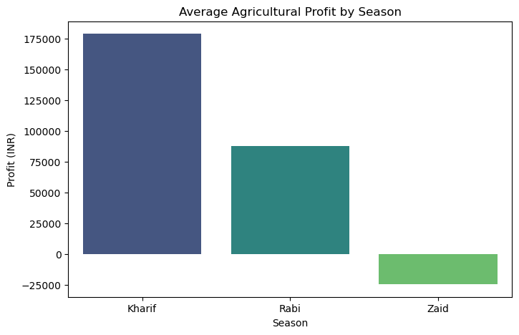
RESULTS

Slide 7
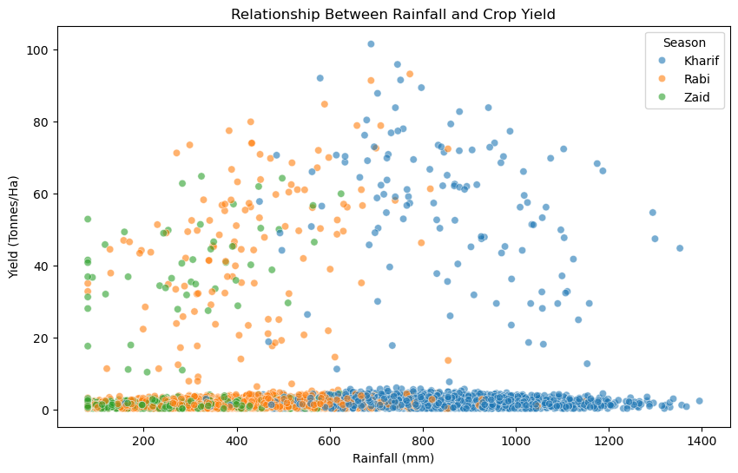
RESULTS

Slide 8
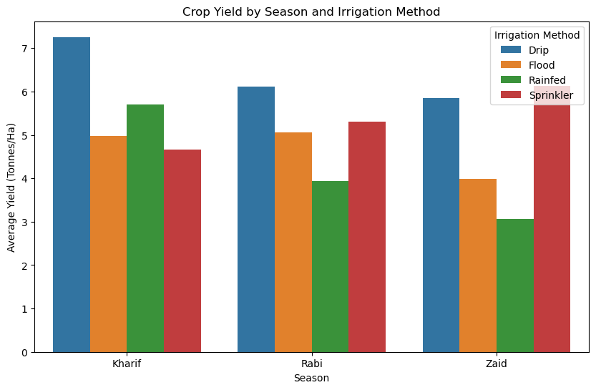
RESULTS

Slide 9
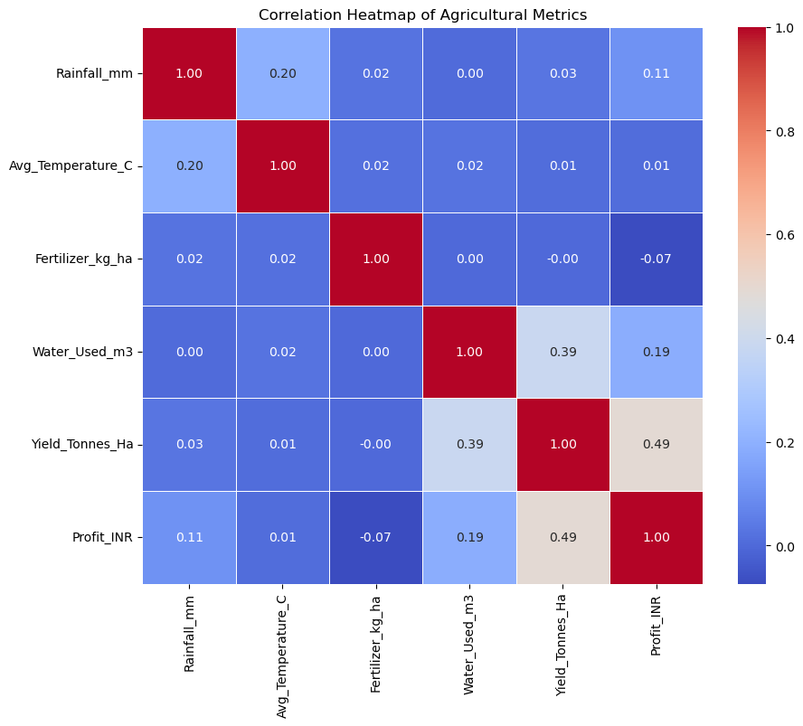
RESULTS

Slide 10
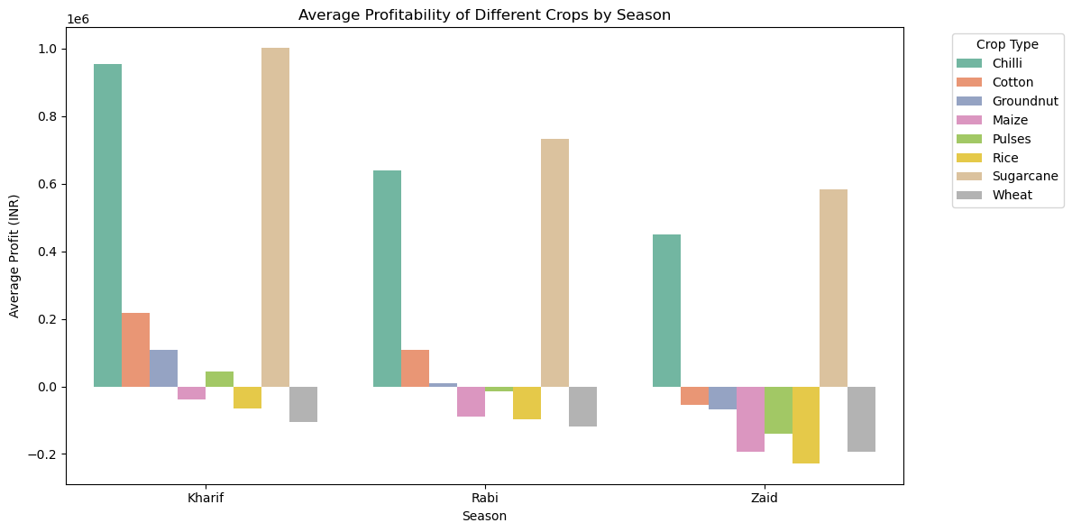
RESULTS

Slide 11
Future scope
Predictive Crop Modeling: Implement machine learning algorithms in Python to forecast future crop yields and market prices based on historical seasonal weather patterns and resource inputs.
Live Data Integration: Connect the existing visual dashboards to real-time weather APIs and IoT soil sensors to provide dynamic, up-to-the-minute agricultural monitoring.
Prescriptive Recommendation Engines: Develop automated systems that suggest the exact optimal irrigation methods and fertilizer quantities for specific crops to maximize profit margins.
Geospatial Mapping (GIS): Incorporate geographic information systems to map regional performance variations down to the district level, allowing localized agricultural planning and pest risk assessment.

Slide 12
GitHub Link
https://github.com/Smruti-Saurav/Seasonal-Agriculture-Performance-Analysis

Slide 13
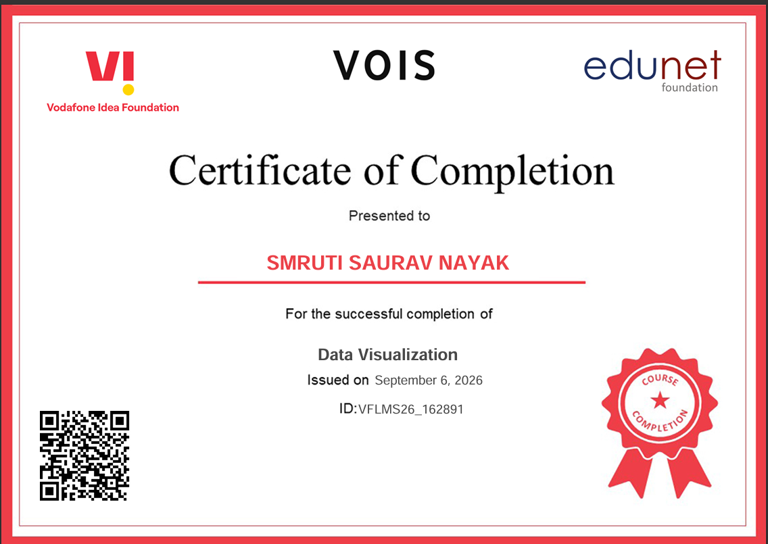
VOIS Course completion certificate - Course name- Data Visualization

Slide 14
Thank you
.
.

